Slide 1
Chapter 8
Security Management

Slide 2
Introduction
Security refers to providing a protection system to computer system resources such as CPU, memory, disk, software programs and most importantly data/information stored in the computer system.
If a computer program is run by unauthorized user then he/ she may cause severe damage to computer or data stored in it.
So a computer system must be protected against unauthorized access, malicious access to system memory, viruses, worms etc.

Slide 3
Security Problem
The operating system can allow users to protect their resources. We say that a system is secure if its resources are used and accessed as intended under all circumstances.
Unfortunately, it is not generally possible to achieve total security.
Security violations of the system can be categorized as being either intentional(malicious) or accidental.
Among the forms of malicious access are the following:
Unauthorized reading of data (theft of information).
Unauthorized modification of data.
Unauthorized destruction of data.

Slide 4
Security Problem
To protect the system, we must take security measures at various levels:
Physical – The site containing the computer system must be physically secured against the suspicious entry. E.g. protection of Data centers, servers, connected terminals.
Human – Proper user authorization, Avoid social engineering, phishing, dumpster diving. E.g a legimate looking e-mail, web page, finding phone books, finding hints of passwords etc.
Operating System – Protect from accidental or purposeful security breaches, protection mechanisms, debugging, updating etc. (finding possible breaches is endless)
Network – Most data today travels over the shared lines like internet, wireless, lease lines etc.

Slide 5
Password Vulnerabilities
The combination of user id and password is usually adequate to avoid hacks. However, passwords give a false sense of security.
There are two general classifications of password vulnerabilities:
Organizational password vulnerabilities
This includes a lack of password policies that are enforced within the organization and a lack of security awareness on the part of users.
Most people just focus on the easy-to-remember password.
Unless users are educated and reminded about using strong passwords, their passwords are usually
a) Easy to guess.
Seldom changed.
Reused for many security points. When bad guys crack one password, they can often access other systems with that same password and username

Slide 6
Password Vulnerabilities
Written down in unsecure places.
The more complex a password is, the more difficult it is to crack.
However, when users create complex passwords, they’re more likely to write them down.
External attackers and malicious insiders can find these passwords and use them against you and your business.

Slide 7
2) Technical vulnerabilities
This includes weak encryption methods and unsecure storage of passwords on computer systems.
The technical vulnerabilities occurs due to
Weak password encryption schemes.
Programs that store their passwords in memory, unsecured files, and easily accessed databases.
Unencrypted databases that provide direct access to sensitive information to anyone with database access, regardless of whether they have a business need to know.
User applications that display passwords on the screen while the user is typing.

Slide 8
Password Encryption
Encryption password is one common method of protecting information transmitted over unreliable links.
The information (text) is encrypted (encoded) from its initial readable form (called plain text), to an internal form (called cipher text).
This internal text form, although readable, does not make any sense.

Slide 9
Password Encryption
The cipher text can be stored in a readable file, or transmitted over unprotected channels.
To make sense of the cipher text, the receiver must decrypt (decode) it back into clear text.
Even if the encrypted information is accessed by an unauthorized person or program, it will be useless unless it can be decoded.

Slide 10
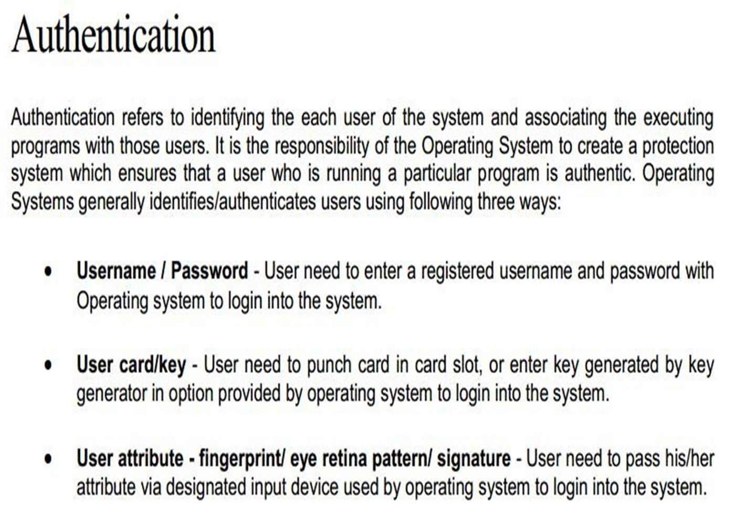

Slide 11
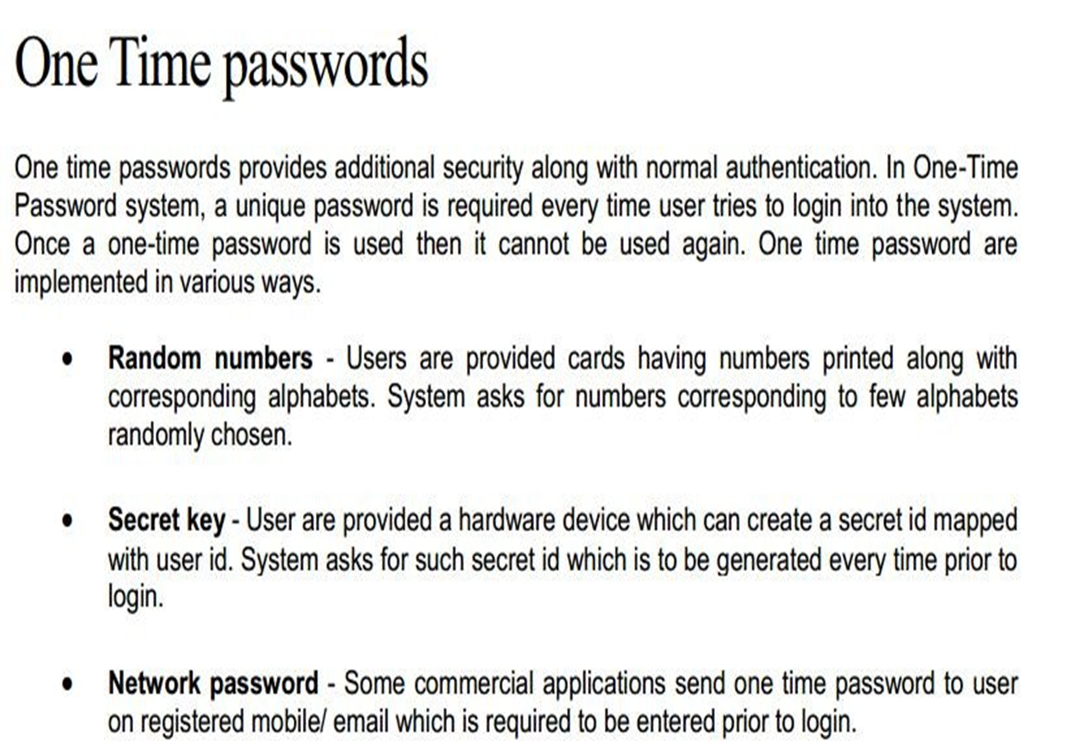

Slide 12
Biometric Password
Biometrics is the measurement and statistical analysis of people's unique physical and behavioral characteristics.
The technology is mainly used for identification and access control, or for identifying individuals who are under surveillance.
The basic premise of biometric authentication is that every person can be accurately identified by his or her intrinsic physical or behavioral traits.

Slide 13
Biometric Password
Authentication by biometric verification is becoming increasingly common in corporate and public security systems, consumer electronics and point-of-sale applications.
In addition to security, the driving force behind biometric
v e r i f i c a t i o n h a s b e e n c o n v e n i e n c e, a s t h e r e a r e no passwords to remember or security tokens to carry.
Some biometric methods, such as measuring a person's gait, can operate with no direct contact with the person being authenticated.

Slide 14
Disadvantages of Biometric password
Components of biometric devices include:
A reader or scanning device to record the biometric factor being authenticated.
Software to convert the scanned biometric data into a standardized digital format and to compare match points of the observed data with stored data.
A database to securely store biometric data for comparison.

Slide 15
Advantages of Biometric password
Hard to fake or steal, unlike passwords.
Ease of use and convenience.
Change little over a user’s life.
Are non-transferrable.
Templates take up less storage.

Slide 16
Disadvantages of Biometric Password
It is costly to get a biometric system up and running.
If the system fails to capture all of the biometric data, it can lead to failure in identifying a user.
Databases holding biometric data can still be hacked.
Errors such as false rejects and false accepts can still happen.
If a user gets injured, then a biometric authentication system may not work (for example user burns their hand, then a fingerprint scanner may not be able to identify them).

Slide 17
User Authorization
Authorization is a security mechanism used to determine user/client privileges or access levels related to system resources, including computer programs, files, services, data and application features.
Authorization is normally preceded by authentication for user identity verification.
System administrators (SA) are typically assigned permission l e v e l s c o v e r i n g a l l s y s t e m a n d u s e r r e s o u r c e s .
During authorization, a system verifies an authenticated user's access rules and either grants or refuses resource access.
So, user authorization is the process of verifying what a user has access to .
Au t h or i zat i on can be det er mi n ed t h r ou gh t h e u se of policies and rules, which can be used with Role Based Access Control(RBAC).

Slide 18
Program Threats
Program threats in operating systems are malicious activities initiated by user programs to cause harm, steal information, or gain unauthorized access. Common types of program threats include:
Virus: Self-replicating code that attaches to executable files, spreading and potentially destroying or corrupting files and system data.
Trojan Horse: Malicious programs disguised as legitimate software, which can steal user credentials or provide unauthorized control over the system.
Trap Door (Backdoor): Hidden security holes in programs that allow unauthorized access or actions without the user's knowledge.
Logic Bomb: Malicious code embedded in a program that activates under certain conditions, causing damage or unauthorized activities.
Stack and Buffer Overflow: Exploiting memory handling vulnerabilities where more data is written to a buffer than it can hold, enabling attackers to execute arbitrary code or crash the system.

Slide 19
System Threats
System threats in operating systems refer to attacks and misuse that exploit system services and resources, often causing disruption, unauthorized access, or resource abuse. These threats differ from program threats as they mainly target system functionalities and network interactions.
Common system threats include:
Worm: A self-replicating program that spreads over a network (especially LANs), consuming system resources by creating copies of itself recursively, which can degrade system performance.
Port Scanning: A technique used by attackers to probe a system’s network ports to find vulnerabilities for exploiting access points.
Denial of Service (DoS) Attack: An attack aimed at making a system or network resource unavailable to legitimate users by exhausting system resources or disrupting network connections. This can use up CPU time or flood network bandwidth.
Theft of Service: Unauthorized use of system resources such as CPU cycles or network bandwidth, often by running unauthorized processes.
Network Intrusion: Unauthorized access or malicious activity on the network that can lead to data theft, system compromise, or service disruptions.

Slide 20
How to protect against a computer virus
Use Anti-Malware Software: Install reputable antivirus or anti-malware software and keep it up to date. This software detects, quarantines, and removes viruses before they can cause harm.
Keep Systems Updated: Regularly update your operating system, software, and antivirus definitions to patch security vulnerabilities that viruses can exploit.
Be Cautious with Email and Downloads: Avoid opening email attachments or clicking links from unknown or suspicious sources. Only download software from trusted and official websites.
Use a Firewall: Enable and configure a firewall to block unauthorized access and suspicious network traffic.

Slide 21
How to protect against a computer virus
Regular Backups: Frequently back up important files to external drives or cloud storage to recover data in case of infection.
Disable Auto-Run: Turn off auto-run features that automatically execute files from external devices to prevent spreading infections.
Avoid Suspicious Websites and Pop-ups: Use pop-up blockers and avoid visiting unsafe websites that may harbor malware.
Minimize Admin Rights: Use non-administrator accounts for routine activities to limit the potential damage of malware infections.
Run Regular Scans: Schedule periodic full system scans with your antivirus program to detect hidden threats.

